Slide 2
Guestology
it’s your GUEST who decides if the experience was a success.

Slide 3
Values:
reach
learn
love

Slide 4
Evaluate Your group’s guest experience

Slide 5
Bible Fellowship Timeline
Before
During
After

Slide 6
Build Your Team
Director
Apprentice director
secretary
prospect coordinator
Greeter

Slide 7
Utilize The Tools
Reports
Reach cards
Own your own section
Guest central
Decision encourager
Call nights
Everyday conversations

Slide 8
Bible Fellowship Timeline
Before
During
After

Slide 10
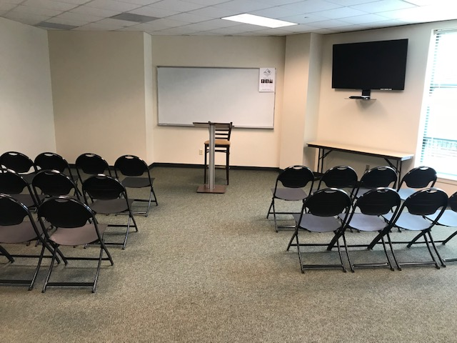

Slide 11
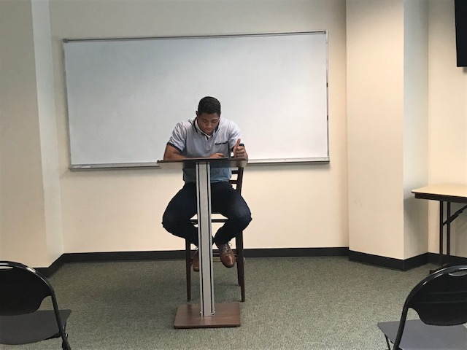

Slide 12
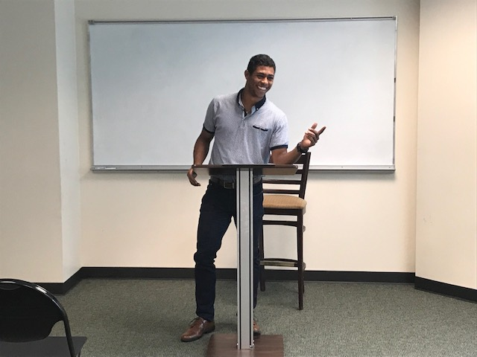

Slide 13
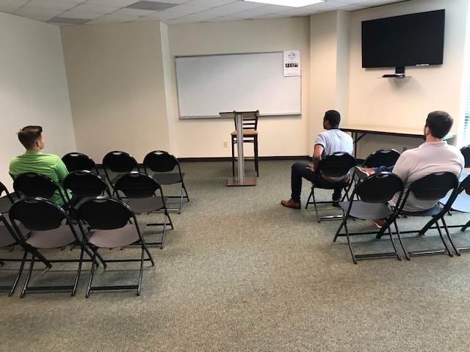

Slide 14
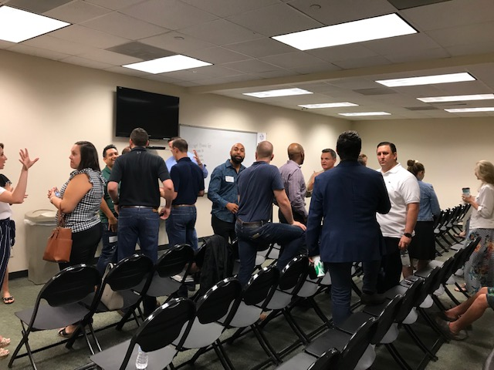

Slide 15
Environment & Attitude

Slide 16
Environment
“Does our room feel welcoming to a guest?”

Slide 18
Attitude
“Do outsiders feel welcome
in our group?”

Slide 19
Attitude – be an owner
A new person or couple is an opportunity
Friends can wait
Be a connector

Slide 20
Bible Fellowship Timeline
Before
During
After

Slide 21
The guest experience does not end in the room…

Slide 22
After Bible Fellowship…
24 Hour rule
Personally invite them to…
Sit with you in worship
Your group next week
Your next Group social
Coffee/lunch/dinner
Add guest to group communications

Slide 23
Conversation Starters
Easy subjects to talk about:
home
Family
Recreation
Church

