Slide 1
Member Coordinator and Shepherd Group Leader

Slide 2
Why This Matters

Slide 3
Relational Nerve Center

Slide 4
Relational Nerve Center
Closing the Back Door

Slide 5
Relational Nerve Center
Closing the Back Door
Ministry Opportunities

Slide 6
The Lego Principle

Slide 7
Pastoring your people

Slide 8
Pastoring your people
In a crisis

Slide 9
Pastoring your people
In a crisis
In prayer

Slide 10
Pastoring your people
In a crisis
In prayer
With God’s Word

Slide 11
Design Ideas

Slide 12
Design Ideas
Groups designed around geographic landmarks

Slide 13
Design Ideas
Groups designed around geographic landmarks
Groups designed based upon attendance patterns

Slide 14
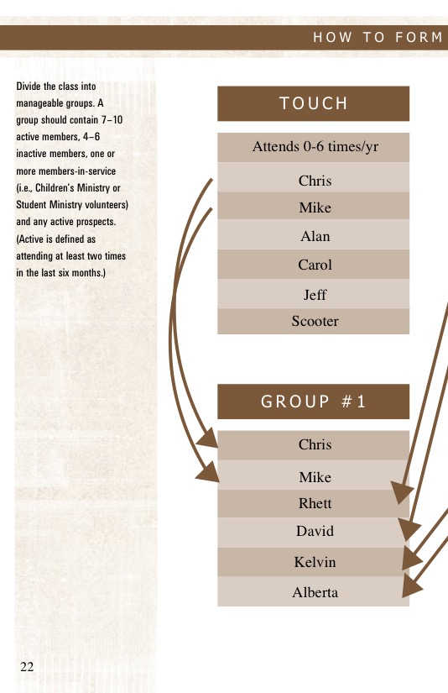
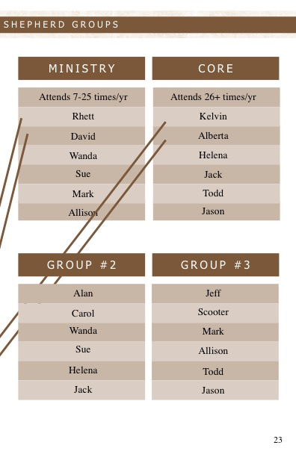
Groups Based On Attendance Patterns

Slide 15
Design Ideas
Groups designed around geographic landmarks
Groups designed based upon attendance patterns
Groups designed randomly

Slide 16
Winning Practices Discussion

Slide 17
What’s been the greatest benefit to establishing Shepherd Groups?

Slide 18
What type of challenges did you face beginning Shepherd Groups?

Slide 19
How often do the Shepherd Groups in your class gather?

Slide 20
When organizing Shepherd Groups, what tips/ideas would you share?

Slide 21
What does a typical Shepherd Group meeting look like?

Slide 22
Are your Shepherd Groups ever reorganized? If so, how often?

Slide 23
How are new members integrated into existing Shepherd Groups?

