Slide 1
Member Care

Slide 2
Member Coordinator
Purpose
To recruit and equip Shepherd Group Leaders as well as ensure members and Shepherd Groups have a reach mindset.
Best Practices
Successfully connects new members with a Shepherd Group
Keeps people engaged with the group
Determines how many Shepherd Groups are needed
Ensures Shepherd Groups Leaders have the tools needed to be successful
Provides accountability
Pray and support Shepherd Group Leaders

Slide 3
Shepherd Group Leader
Purpose
The Shepherd Group Leader is responsible for ministering to 4-8 people (2-4 couples).
Best Practices
Serves as the relational connector between the shepherd group members and the Bible Fellowship Group. Makes the “big” group small
Stays in regular contact with shepherd group members to see if there are any prayer requests or ministry needs that the Bible Fellowship Group can meet
Helps provide and/or facilitate opportunities for the shepherd group members to get together
Works alongside Member Coordinator to successfully form Shepherd Groups

Slide 4
Shepherd Group Leader
How to successfully form a Shepherd Group
Two Ways
Attendance Patterns
Divide Roster into groups using attendance patterns
Committed (26+ times per year), Engaged (7-25 times per year), Occasional (7 or less times per year)
Determine the number of Shepherd Groups by assigning each group the following
Two Committed members/couples
Two Engaged members/couples
One occasional member/couple
Geographic Location
Determine the number of Shepherd Groups by assigning groups by location
Incorporate attendance patterns as much as possible to connect group members who attend less often

Slide 5
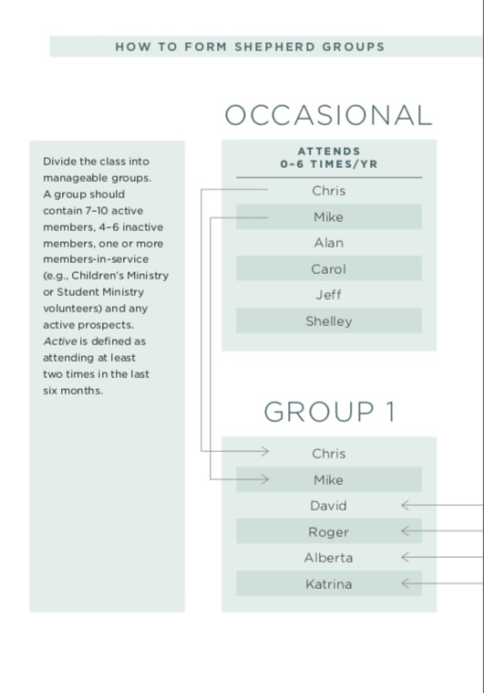
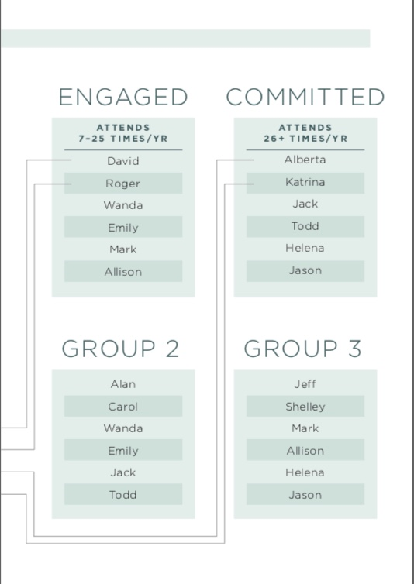

Slide 6
Social Coordinator
Purpose
To provide opportunities for group members and guests to build relationships with each other, and to help assimilate new members and guests into the group.
Best Practices
Remembers the why
Determines the need
Puts together a team
Keeps an up to date list of members and prospects
Understands the reach strategy

Slide 7
Prayer Coordinator
Purpose
To lead the class in effective intercessory prayer and express thankfulness to to God for answered prayer and praises.
Best Practices
Develops an efficient method of identifying and communicating prayer requests each week.
Ensures that prayer is a key element of each class.
Prays daily for the needs of members, guests, and our church family
Inform sthe Director and Divisional Minister of
urgent prayer needs
Prays for the Sunday Worship Services when
assigned

